Slide 1
System Integration Testing
Course Code: CSC4133
Course Title: Software Quality and Testing
Dept. of Computer Science
Faculty of Science and Technology
Lecturer No: | 19 | Week No: | 11 | Semester:
Lecturer: | Name & email

Slide 2
Lecture Outline
The Concept of Integration Testing
Different Types of Interfaces
Different Types of Interface Errors
Granularity of System Integration Testing
System Integration Techniques
Test Plan for System Integration
Off-the-self Component Integration
Off-the-shelf Component Testing

Slide 3
Objectives and Outcomes
Objectives: To understand the basic concept of system integration testing, to understand different types of interfaces and interface errors, to understand the different techniques of system integration, to understand Off-the-self Component Integration.
Outcomes: Students are expected to be able to explain system integration testing, be able to explain five different techniques of system integration, be able to explain the challenges in Off-the-self Component Integration.

Slide 4
The Concept of Integration Testing
A software module is a self-contained element of a system
Modules are individually tested commonly known as unit testing
Next major task is to put the modules (i.e., pieces) together to construct the complete system
Construction of a working system from the pieces is not a straightforward task because of numerous interface errors
System integration testing is a systematic technique for assembling a software system while conducting tests to uncover errors associated with interfacing

Slide 5
The Concept of Integration Testing
The objective of system integration testing (SIT) is to build a “working” version of the system by –
− Putting modules together in an incremental manner
− Ensuring that the additional modules work as expected without disturbing the functionalities of the modules already put together

Slide 6
The Concept of Integration Testing
Integration testing usually proceeds from small subassemblies containing a few modules to larger ones containing more and more modules. Large, complex software products can go through several iterations of build-and-test cycles before they are fully integrated.
Integration testing is said to be complete when
− The system is fully integrated together
− All the test cases have been executed
− All the severe and moderate defects found have been fixed

Slide 7
Advantages of conducting SIT
The major advantages of conducting SIT are as follows:
− Defects are detected early
− It is easier to fix defects detected earlier
− We get earlier feedback on the health and acceptability of the individual modules and on the overall system
− Scheduling of defect fixes is flexible, and it can overlap with development

Slide 8
Different Types of Interfaces
Three common paradigms for interfacing modules:
Procedure call interface: A procedure in one module calls a procedure in another module. The caller passes on control to the called module. The caller can pass data to the called procedure, and the called procedure can pass data to the caller while returning control back to the caller.
Shared memory interface: A block of memory is shared between two modules. The memory block may be allocated by one of the two modules or a third module. Data are written into the memory block by one module and are read from the block by the other.
Message passing interface: One module prepares a message by initializing the fields of a data structure and sending the message to another module. This form of module interaction is common in client-server based systems and web-based systems.

Slide 9
Interface errors
Question: “If all the unit-tested modules work individually, why can these modules not work when put together?”
− The problem arises when we “put modules together” because of interface errors.
− Interface errors: Interface errors are those that are associated with structures existing outside the local environment of a module, but which the module uses.

Slide 10
Different Types of Interface Errors
Construction
Inadequate functionality
Location of functionality
Changes in functionality
Added functionality
Misuse of interface
Misunderstanding of interface
Data structure alteration
9) Inadequate error processing
10) Additions to error processing
11) Inadequate post-processing
12) Inadequate interface support
13) Initialization/value errors
14) Violation of data constraints
15) Timing/performance problems
16) Coordination of changes
17) Hardware/software interfaces

Slide 11
Granularity of System Integration Testing
SIT is performed at different levels of granularity. Integration testing includes both white-box and black-box testing approaches.
Various levels of granularities in SIT are :
Intra-system testing : This form of testing constitutes low-level integration testing with the objective of combining the modules together to build a cohesive system
Inter-system testing: It is a high-level testing phase which requires interfacing independently tested systems
Pair-wise testing: In pair-wise integration, only two interconnected systems in an overall system are tested at a time.

Slide 12
System Integration Testing
One of the objectives of integration testing is to combine software modules into a working system so that system-level tests can be performed on the complete system.
Integration testing need not wait until all the modules of a system are coded and unit tested. Instead, it can begin as soon as the relevant modules are available.

Slide 13
System Integration Techniques
Commonly used system integration techniques:
Incremental
Top-down
Bottom-up
Sandwich
Big-bang
Pre-requisite for integration testing
− A module must be available to be integrated.
− A module is said to available for combining with other modules when the module’s check-in request form is ready.

Slide 14
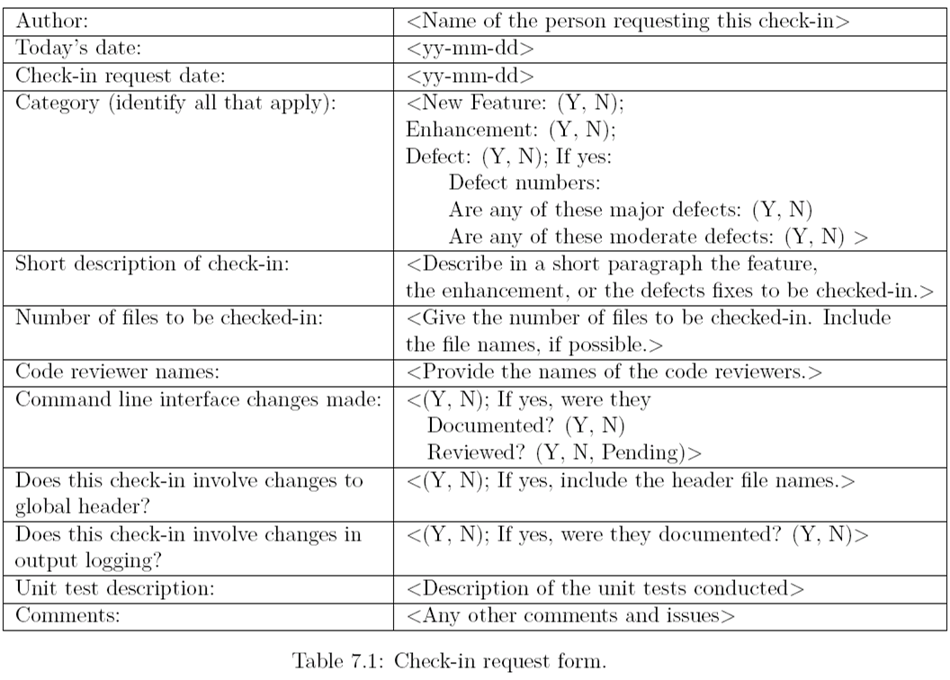
Check-in Request Form

Slide 15
Incremental Integration
In this approach, Integration testing is conducted in an incremental manner as a series of test cycles.
In each test cycle, a few more modules are integrated with an existing and tested to generate a larger build.
Key idea: Complete one cycle of testing, let the developers fix all the defects found, and continue the next cycle of testing.
The complete system is built incrementally, cycle by cycle, until the whole system is operational and ready for system-level testing.
The system is built as a succession of layers, beginning with some core modules. In each cycle, a new layer is added to the core and tested to form a new core. The new core is intended to be self-contained and stable.
This technique is widely used in the industry.

Slide 16
Incremental Integration
Advantages:
The incremental approach has the advantage that the defects are found early in a smaller assembly when it is relatively easy to detect the cause.
Disadvantages:
A disadvantage is that it can be time-consuming since stubs and drivers have to be developed and used in the test.

Slide 17
Top-down integration
In Top-down approach, testing takes place from top to down following the control flow of the software system.
Takes help of stubs for testing.

Slide 18
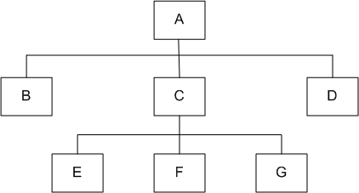
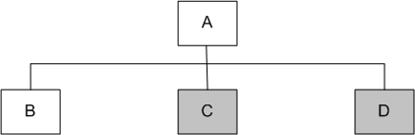
Top-down integration
Figure 7.1: A module hierarchy with three levels and seven modules
Figure 7.2: Top-down integration of modules A and B
First integrate modules A and B using stubs C` and D` (represented by grey boxes)
Next stub D` has been replaced with its actual instance D

Slide 19
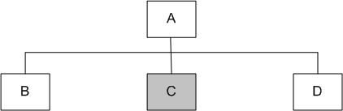
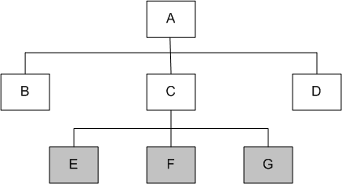
Top-down integration
Figure 7.3: Top-down integration of modules A, B and D
Figure 7.4: Top-down integration of modules A, B, D and C
Stub C` has been replaced with the actual module C, and new stubs E`, F`, and G`

Slide 20
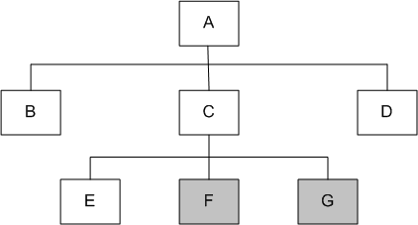
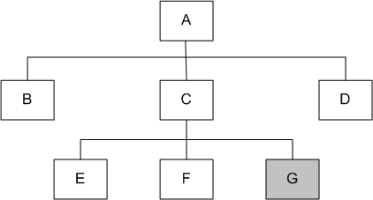
Top-down integration
Figure 7.5: Top-down integration of modules A, B, C, D and E
Figure 7.6: Top-down integration of modules A, B, C, D, E and F

Slide 21
Advantages of Top-down integration
Advantages
SIT engineers continually observe system-level functions as the integration process continues
Isolation of interface errors becomes easier because of the incremental nature of the top-down integration
Test cases designed to test the integration of a module M are reused during the regression tests performed after integrating other modules

Slide 22
Disadvantages of Top-down integration
Disadvantages
Basic functionality is tested at the end of cycle
It may not be possible to observe meaningful system functions because of an absence of lower level modules and the presence of stubs.
Test case selection and stub design become increasingly difficult when stubs lie far away from the top-level module.

Slide 23
Bottom-up integration
In bottom-up approach, system integration begins with the integration of lowest level modules. Each module at lower levels is tested with higher modules until all modules are tested. It takes help of Drivers for testing.
A module is said to be at the lowest level if it does not invoke another module. It is assumed that all the modules have been individually tested before.
To integrate a set of lower level modules, we need to construct a test driver module that invokes the modules to be integrated. Once the integration of a desired group of lower level modules is found to be satisfactory, the driver is replaced with the actual module and one more test driver is used to integrate more modules with the set of modules already integrated. The process of bottom-up integration continues until all the modules have been integrated.

Slide 24
Bottom-up integration
We design a test driver to integrate lowest-level modules E, F, and G
The test driver mimics module C to integrate E, F, and G in a limited way.
The test driver is replaced with actual module , i.e., C.
A new test driver is used
At this moment, more modules such as B and D are integrated
The new test driver mimics the behavior of module A
Finally, the test driver is replaced with module A and further test are performed after the testers are satisfied

Slide 25
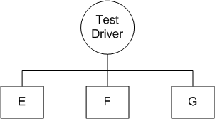
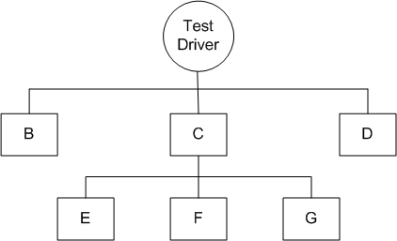
Bottom-up integration
Figure 7.8: Bottom-up integration of module E, F, and G
Figure 7.9: Bottom-up integration of module B, C, and D with E, F, and G

Slide 26
Bottom-up integration
Advantages:
If the low-level modules and their combined functions are often invoked by other modules, then it is more useful to test them first so that meaningful effective integration of other modules can be done.
Disadvantages:
Discovery of major flaws in system design may not be possible until the top-level modules have been integrated.
Test engineers can not observe system-level functions from a partly integrated system.
We can catch the Key interface defects at the end of cycle

Slide 27
Big-bang
Big-bang Approach
First all the modules are individually tested.
Next, all those modules are put together to construct the entire system which is tested as a whole.
− All the modules are integrated together at once and then tested
Sometimes developers use this approach for integrating small systems. However, for large systems, this approach is not recommended.

Slide 28
Big-bang
Advantage
Big Bang testing has the advantage that everything is finished before integration testing starts.
Disadvantage:
The major disadvantage is that in general it is time consuming and difficult to trace the cause of failures because of this late integration.

Slide 29
Sandwich
Sandwich Approach:
In this approach, a system is integrated by using a mix of top-down, bottom-up, and big-bang approaches
A hierarchical system is viewed as consisting of three layers
The bottom-up approach is applied to integrate the modules in the bottom-layer
The top layer modules are integrated by using top-down approach
The middle layer is integrated by using the big-bang approach after the top and the bottom layers have been integrated

Slide 30
Test Plan for System Integration
System integration requires a controlled execution environment, much communication between the developers & the test engineers.
Integrating a large system is a challenging task, which is handled with much planning in the form of developing a SIT plan.
A useful framework for preparing an SIT plan is outlined in the next slide.

Slide 31
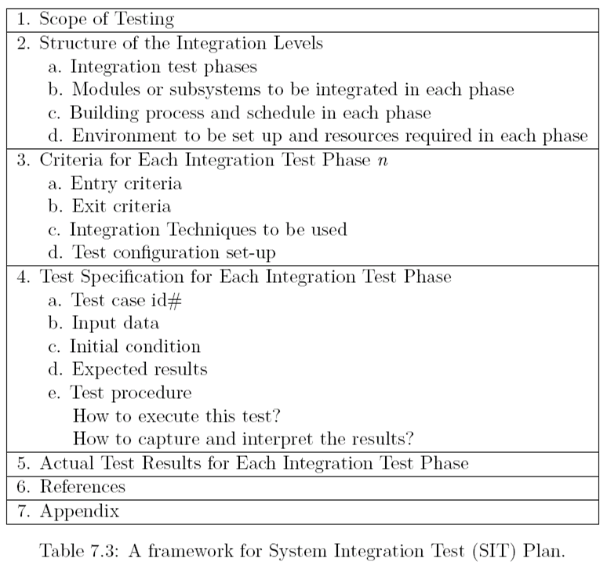
Test Plan for System Integration

Slide 32
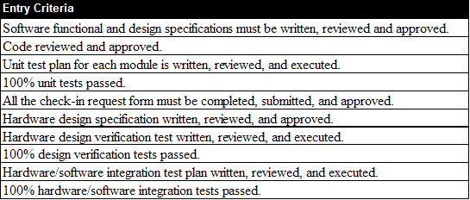
Entry Criteria for SIT
Table 7.4: A framework for system integration entry criteria

Slide 33
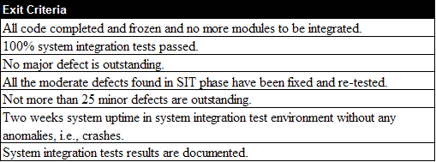
Exit Criteria for SIT
Table 7.5: A framework for system integration exit criteria

Slide 34
Test Plan for System Integration
Categories of System Integration Tests (included in an integration test plan):
Interface integrity - Internal and external interfaces are tested as each module is integrated
Functional validity- Tests are designed to uncover functional errors in each module after it is integrated with the system.
End-to-end validity -Tests are performed to ensure that a completely integrated system works together from end-to-end.
Pair-wise validity -Tests are performed to ensure that any two systems work properly when connected together by a network
Interface stress -Tests are performed to ensure that the interfaces can sustain the load
System endurance-Tests are performed to ensure that the integrated system stay up for weeks without any crashes

Slide 35
Off-the-self Component Integration
Instead of developing a software component from scratch, organizations occasionally purchase off-the-shelf (OTS) components from third-party vendors and integrate them with their own components.
A major issue that can arise while integrating different components is mismatches among code pieces developed by different parties usually unaware of each other.
OTS components produced by the vendor organizations are known as commercial off-the-shelf (COTS) components.

Slide 36
Challenges of COTS Component Integration
Integration not always trivial; incompatibilities among vendors
The buyer has no access to the source code
Dependence on vendor – the vendor controls it development
Stability of the vendor – Vendors can go out of business, can be purchased by other companies or completely drop support for a product

Slide 37
Off-the-shelf Component Testing
Three types of testing techniques are used to determine the suitability of a COTS component:
Black-box component testing: This is used to determine the quality of the component.
System-level fault injection testing: This is used to determine how well a system will tolerate a failing OTS component.
Operational system testing: This kind of tests are used to determine the tolerance of a software system when the OTS component is functioning correctly. Operational system test is conducted to ensure that an OTS component is a good match for the system.

Slide 38
Books
Software Testing and Quality Assurance: Theory and Practice, by Kshirasagar Naik, Priyadarshi Tripathy

Slide 39
References
Software Quality Engineering: Testing, Quality Assurance and Quantifiable Improvement, by Jeff Tian
Software Quality Assurance: From Theory to Implementation, by Daniel Galin
The Art of Software Testing, by Glenford J. Myers, Corey Sandler and Tom Badgett

